Slide 1
SHARMA BHAVESHKUMAR PANKAJBHAI
Enrollment - 230840131124
Stream - Computer Science and Engineering
College - R.N.G. Patel Institute of Technology
Date - 06 July 2026

Slide 2

THINGS I LERANED
Sustainable Development Goals (SDGs)
The collection of 17 SDGs works toward achieving sustainable development within the 2030 timeframe.
The SDG I find most compelling: SDG 17 – Partnerships for the Goals
Promotes cooperative efforts among governmental bodies, business sectors, and private citizens.
Fosters creative solutions and worldwide environmental responsibility.
AI Data Center Documentary
Data centers supporting AI operations require substantial quantities of electrical power and water resources.
The expansion of AI technology leads to heightened energy consumption and greenhouse gas output.
Environmentally conscious AI approaches encompass:
Sustainable Energy Sources
Advanced Temperature Control Methods
Power Usage Enhancement

Slide 3
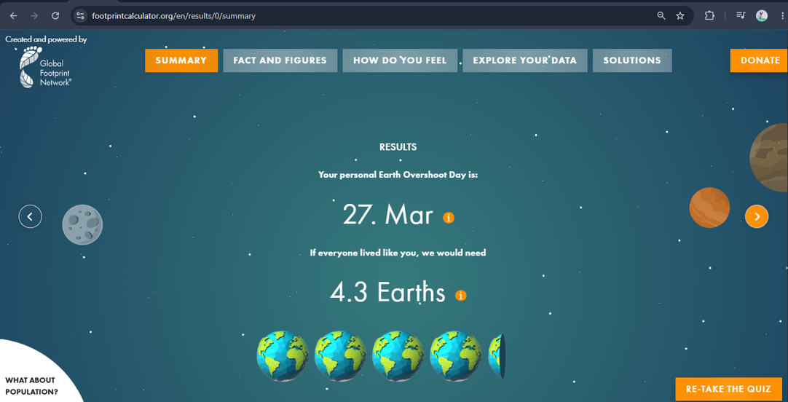
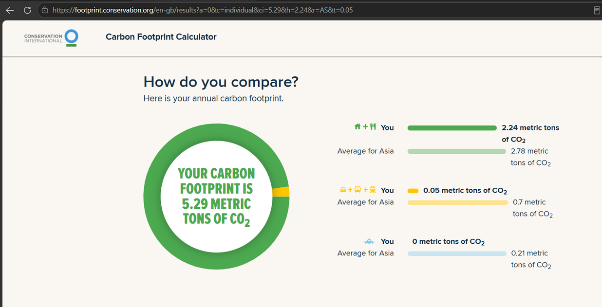
Ecological Footprint Calculator
Personal ecological footprint
Carbon Footprint Calculator
Household emissions
Transportation emissions

Slide 4
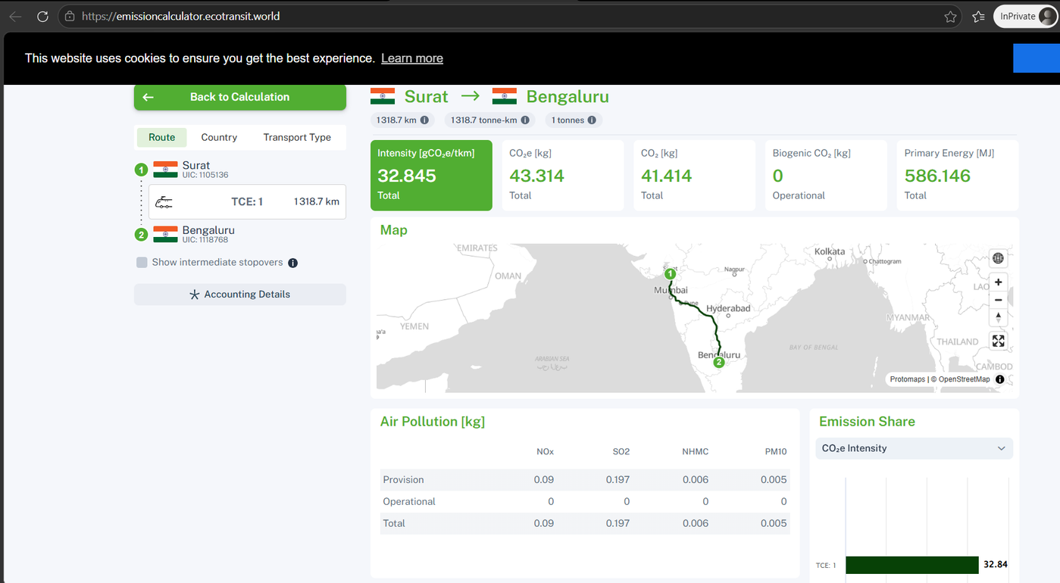
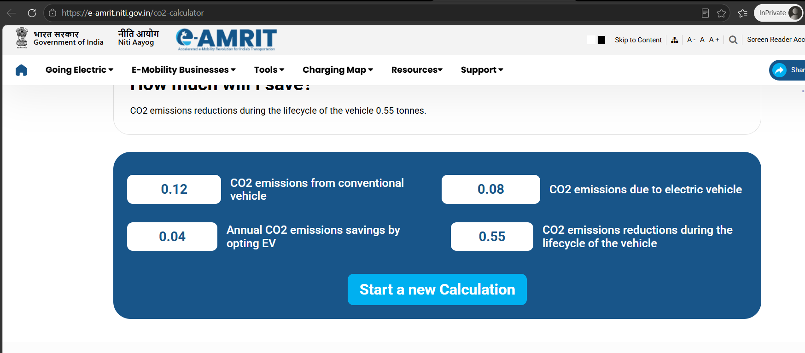
EcoTransit CO₂ Calculator
Comparison of transport emissions
e-AMRIT CO₂ Calculator
Vehicle emission analysis

Slide 5
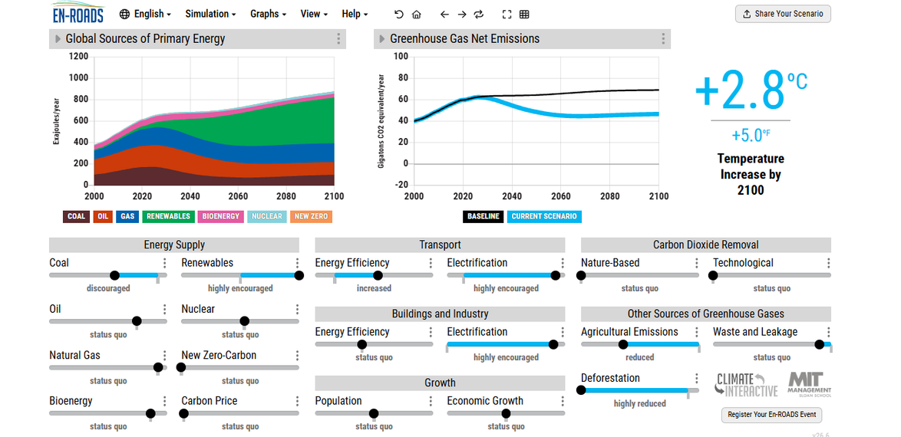
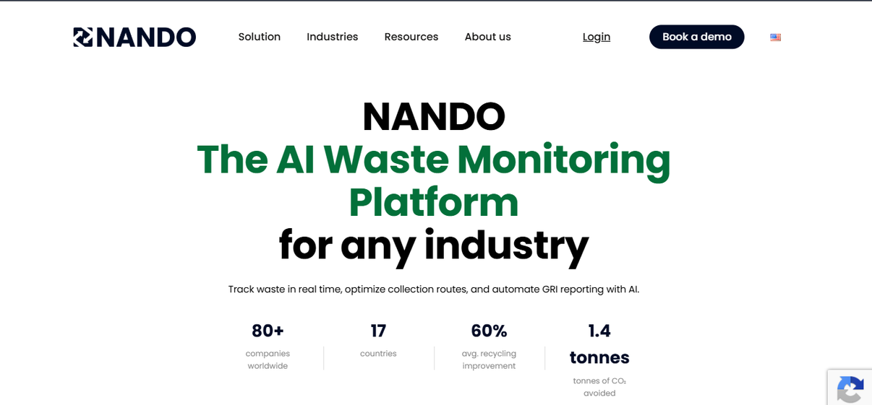
En-ROADS Climate Simulator
Climate policy simulation
NANDO AI
AI-powered waste monitoring

Slide 6
Green Skilling, Sustainability & AI
Green Skilling
Builds expertise in environmentally responsible practices and hands-on capabilities.
Generates job opportunities within sustainable sectors.
Encourages the adoption of earth-conscious methods.
Sustainability
Harmonizes social well-being, environmental health, and economic growth.
Preserves Earth's natural assets.
Enables ongoing ecological safeguarding for future generations.
AI for Sustainability
Technology-driven farming techniques for optimal resource use
Strategic power consumption management
Assessment and tracking of greenhouse gas outputs
Challenges
Excessive power requirements
Significant water consumption for cooling facilities
Accumulation of discarded electronic equipment
Greenhouse gas production from AI computing infrastructure

Slide 7
CAPSTONE PROJECT - AI Campus Sustainability Dashboard
Problem Statement
Educational institutions often lack a centralized system to monitor electricity usage, water consumption, waste generation, and sustainability performance.
Proposed Solution
Develop a dashboard that tracks campus sustainability metrics and provides AI-driven recommendations for improvement.
AI Component
Predictive analytics and anomaly detection.
Related SDGs: 11, 12, 13, 17

